Slide 1


An EU Harmonised Approach to Early Feasibility Studies
Tom Melvin
Associate Professor in Medical Device Regulatory Science, Institute for Clinical Trials
Chair, Regulatory Affairs Committee, Biomedical Alliance

Slide 2






Bringing medical technology innovations to patients in the EU has become increasingly long and difficult.
The Challenge
Uncertainty for innovators.
Rising R&D costs.
Increasingly complex EU regulations.
Decline in attractiveness of Europe.
Lack of harmonised approaches in Member States for facilitating early evidence generation.
European patients missing out on the latest medical technology innovations.

Slide 3

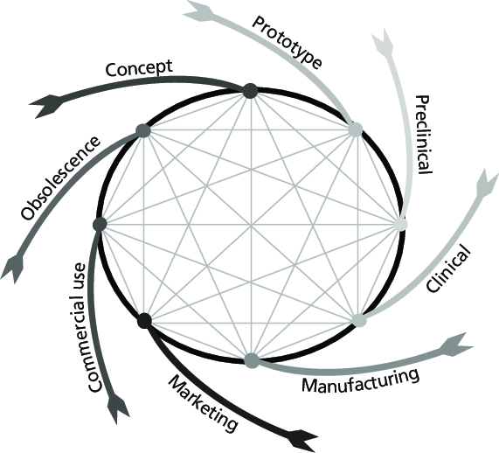
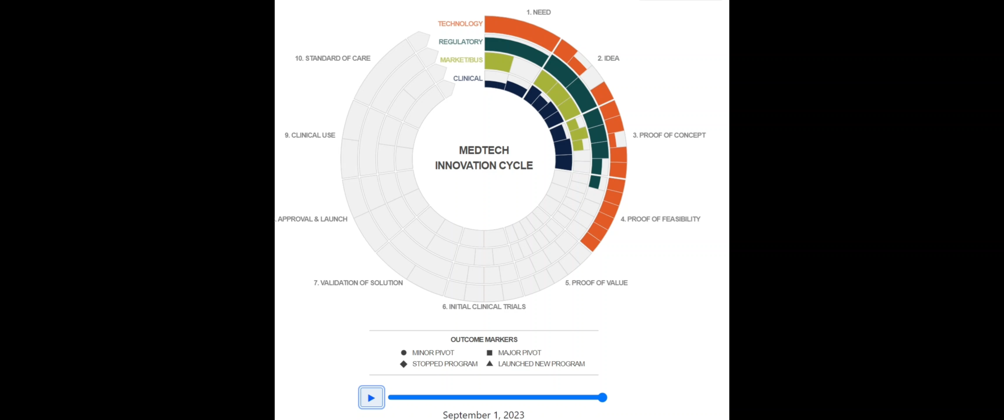
Medical Device
Ref. www.gaits.org

Slide 4
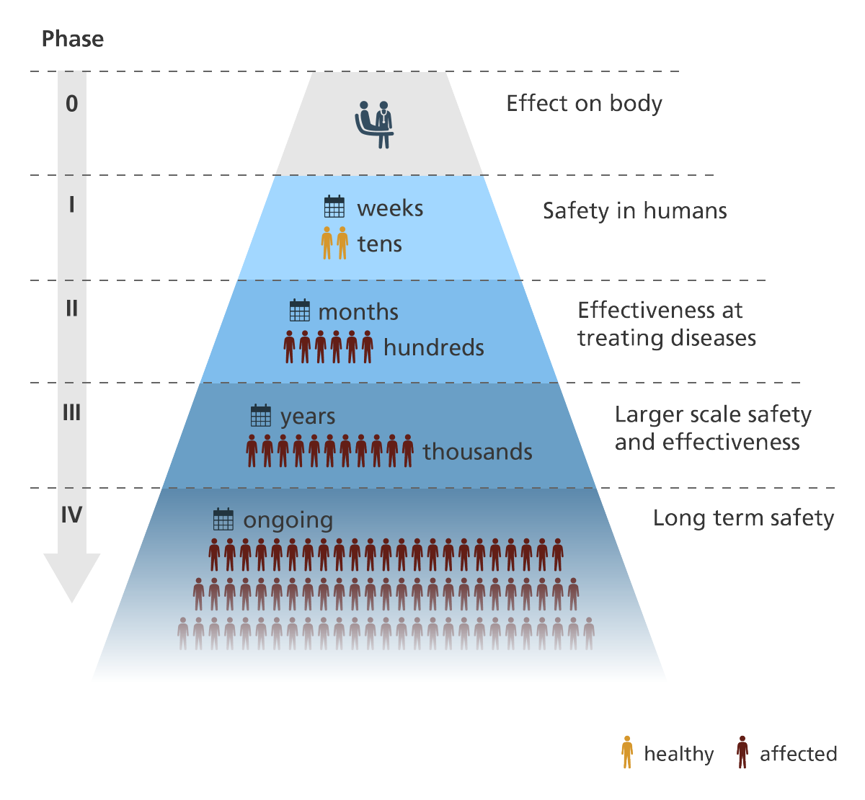
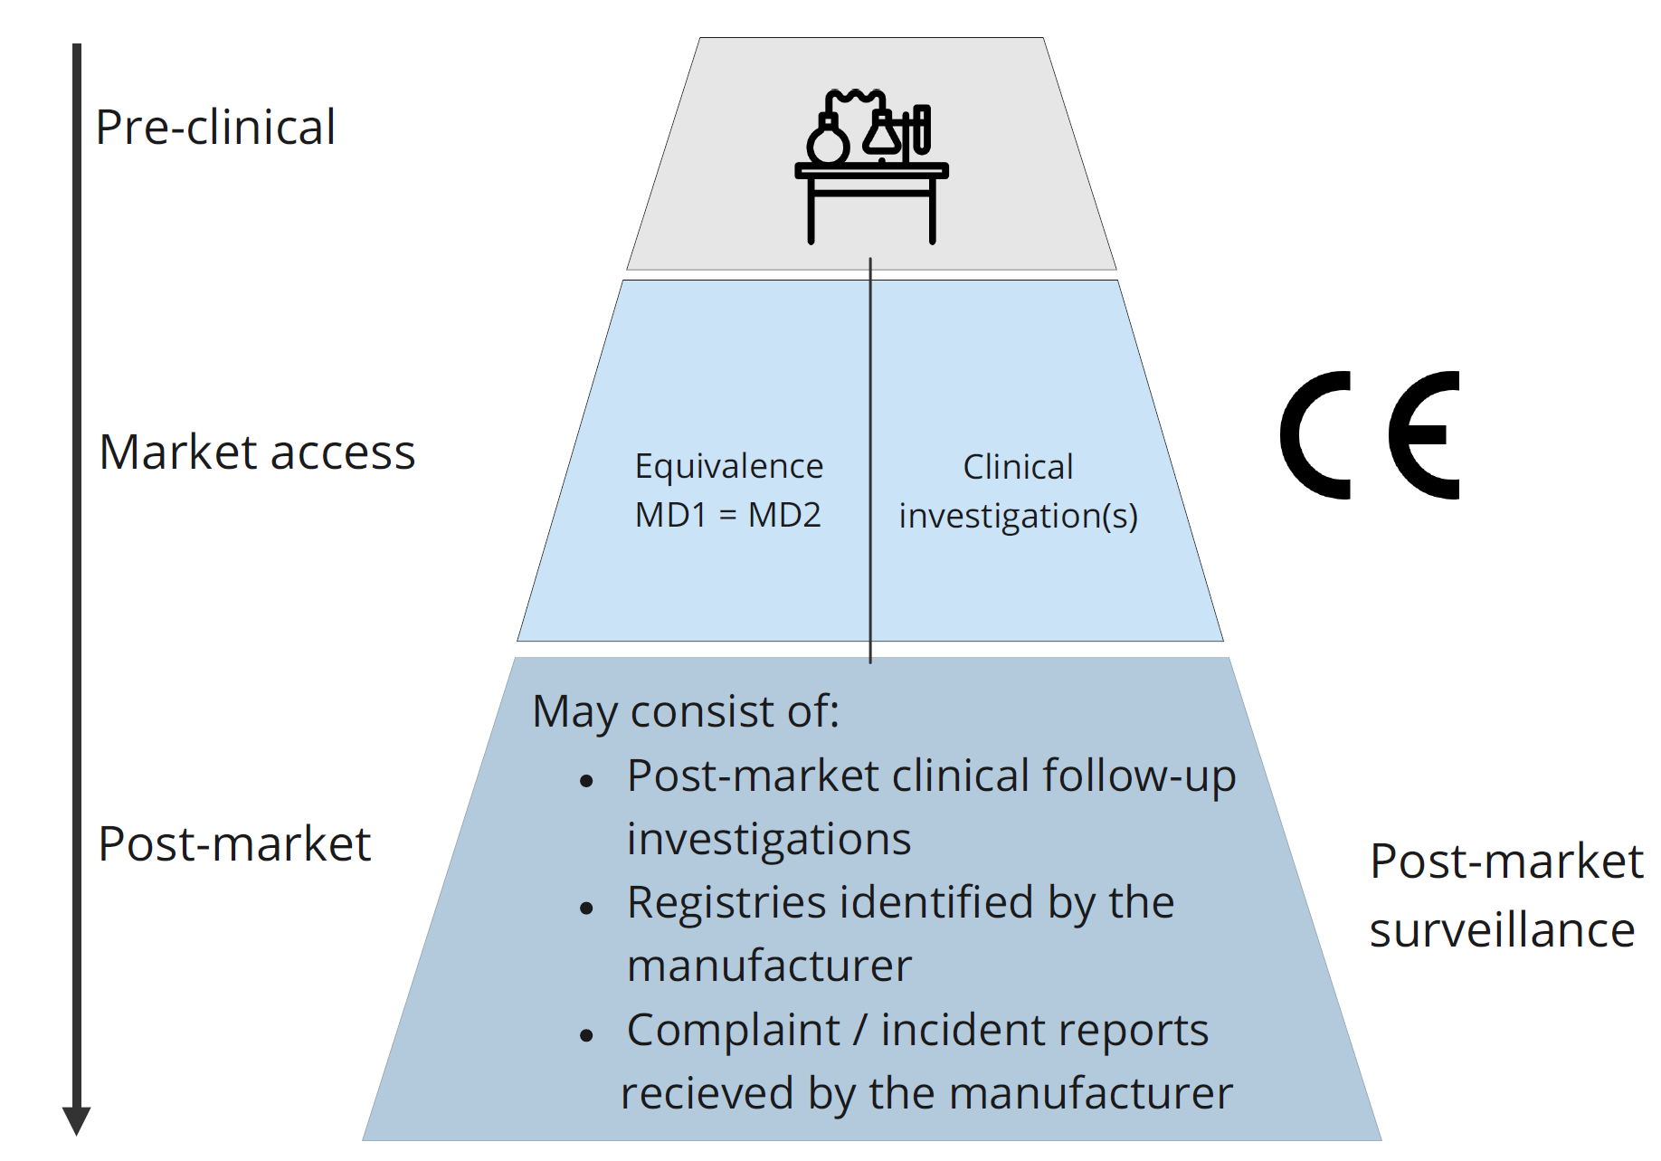
Clinical development for medicines and medical devices

Slide 5

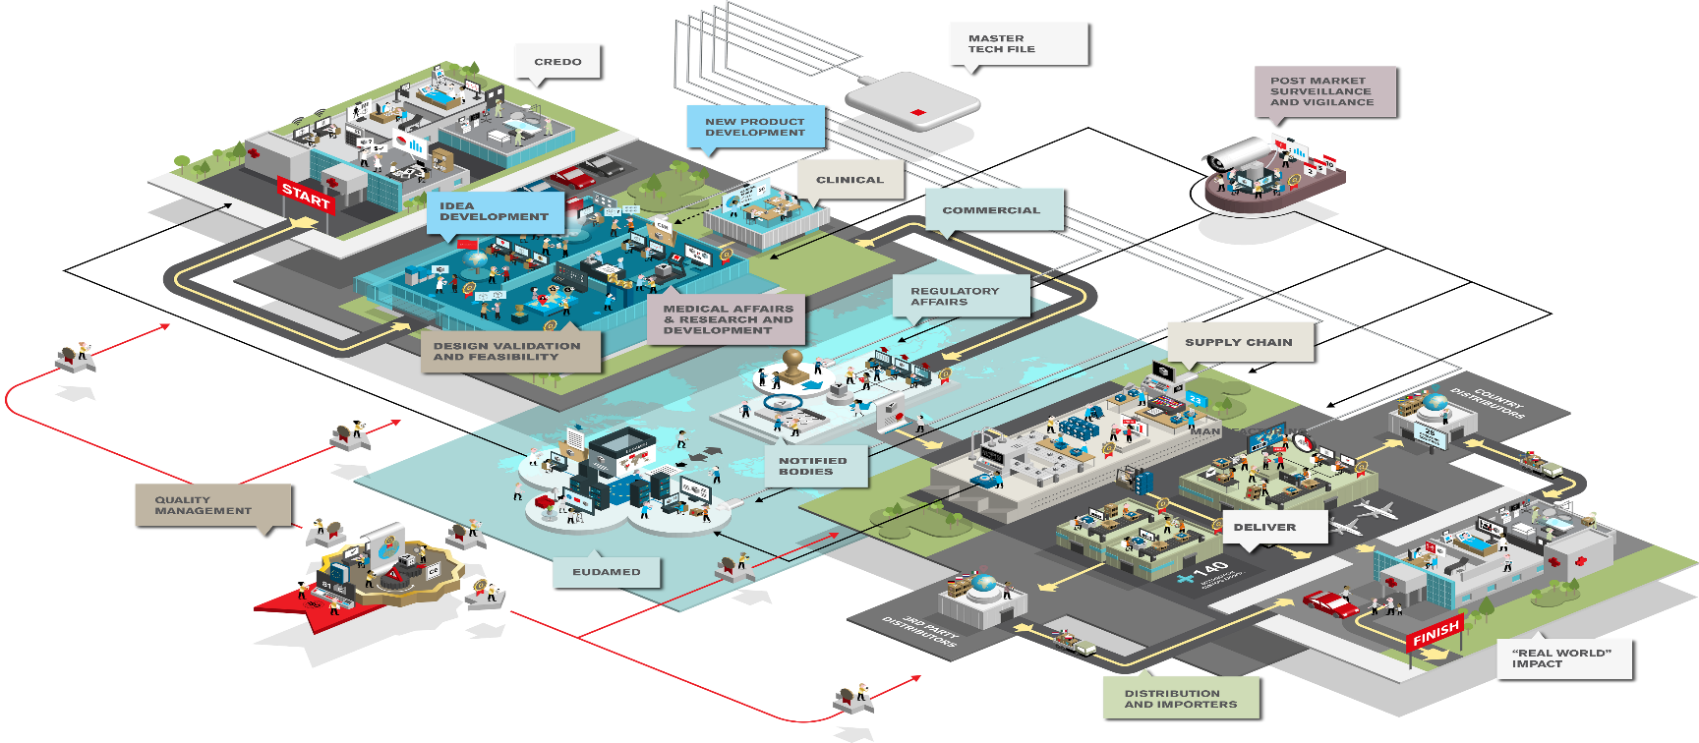
Organisational factors
‘Small’ MedTech
‘Big’ MedTech
Starting from scratch
Limited resources, time and funding
Questions are often encountered for the first time
Leverage documents/experience from other products
Experience of clinical trial processes in multiple countries

Slide 6
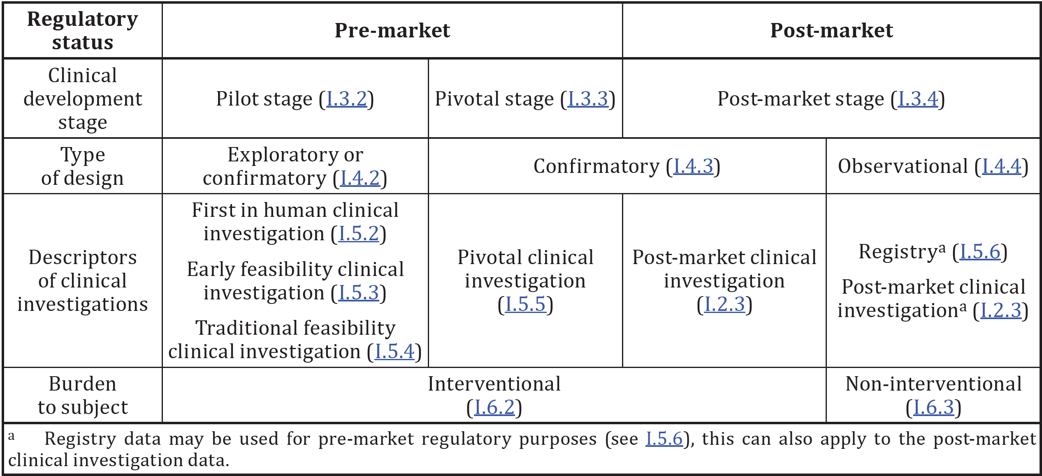
Early Feasibility Studies (EFS)
WHAT?
A limited clinical investigation of a device early in development.
WHEN?
typically before the device design has been finalized, for a specific indication
ISO 14155:2020, Annex I

Slide 7
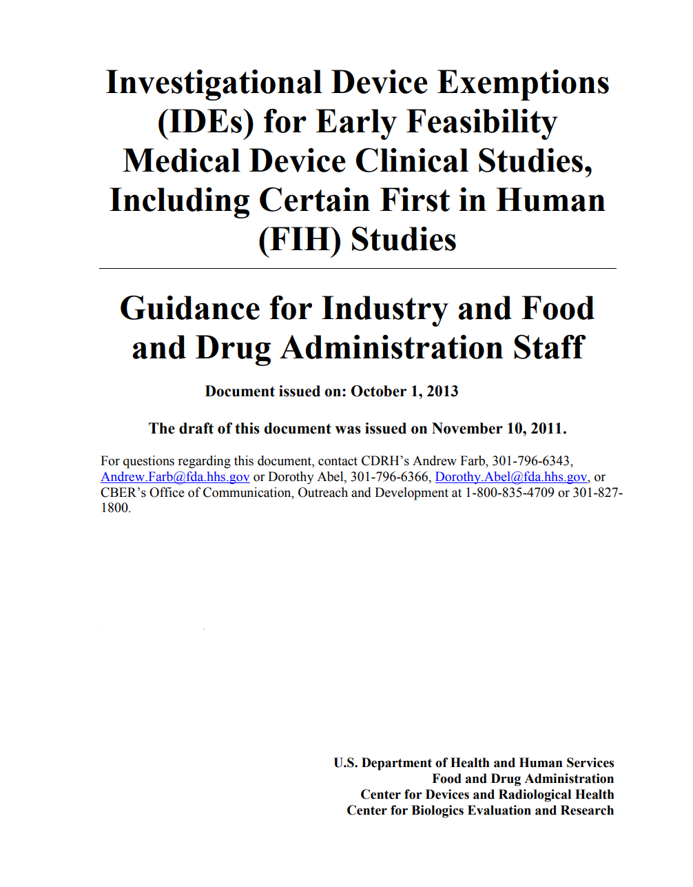
US FDA Early Feasibility Program
Dr. Andrew Farb, Division of Cardiovascular Devices at US FDA noted “a palpable time lag in the availability of some beneficial medical devices for U.S. patients”
Ref. https://www.fda.gov/training-and-continuing-education/cdrh-learn/transcript-ides-early-feasibility-medical-device-clinical-studies-including-first-human-fih-studies

Slide 8
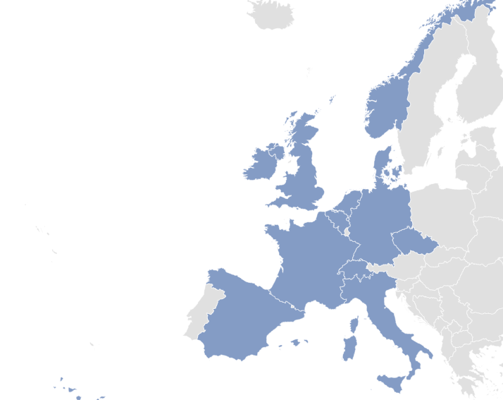
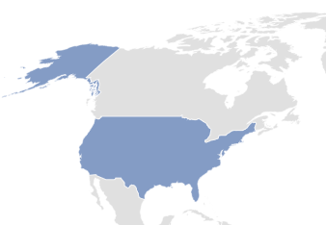








The HEU-EFS Consortium
ACADEMIA
HTA AGENCIES
HEALTH CARE PROVIDERS
Assistance Publique Hôpitaux De Paris
AGENAS, Italy
Bocconi University (leader)
Fundació Clínic per a la Recerca Biomèdica & Hospital Clínic de Barcelona
NIPH, Norway
Marburg University
Fondazione Policlinico Universitario Agostino Gemelli IRCCS
Odense Hospital
University of Galway
PATIENT ORGANISATIONS
SMEs
CRO
Meditrial
Carmat
European Patients’ Forum
Global Heart Hub
Newronika
Idris Oncology
Qurasoft
TECHNOLOGY DEVELOPERS
Edwards Lifescience (coordinator)
Medtronic
DePuy Synthes
Philips
WL Gore
Abbott
This project is supported by the Innovative Health Initiative Joint Undertaking (JU) under grant agreement No 101112185. The JU receives support from the European Union’s Horizon Europe research and innovation programme and life science industries represented by MedTech Europe, COCIR, EFPIA, Vaccines Europe and EuropaBio.
www.heuefs.eu

Slide 9
EU level clinical investigation activity
Country-level variation in the proportion of lower-risk versus higher-risk device submissions received by National Competent Authorities in 2023
Distribution of EFS applications by device risk classification and digital health technology (DHT) status. A total of 46 EFS applications were reported across 6 NCAs.

Slide 10
Who assesses clinical investigations in Competent Authorities?
National Competent Authority Distribution of Assessor Expertise Across Clinical, Regulatory, and Technical Domains
Frequency of External Assessor Use Among EU National Competent Authorities in Clinical Investigation Assessments

Slide 11
Dialogue with National Competent Authorities

Slide 12
Next steps in HEU-EFS
Templates, methods and procedures in development
Piloted on real world clinical studies supported by the private consortium
Pilots used to refine recommendations
Project runs to September 2027

Slide 13

Thank you tom.melvin@UniversityofGalway.ie
www.heuefs.eu

