Slide 1


HEU-EFS
Harmonized Approach for Medical Devices in the European Union to Early Feasibility Studies
An Innovative Health Initiative Project
Adrian Valledor
Laura Sampietro-Colom MD, PhD MScPH
Evaluation of Innovation and New Technologies Dept.

Slide 2
Introduction: Context
  Why EFS?
  Characteristics of an EFS
  Why an EFS program in the EU?
The HEU-EFS Project
  Objectives
  Partners and stakeholders
  Deliverables

Slide 3






Introduction: Context (I)
Why EFS?
Bringing medical technological innovations to EU patients has become increasingly long and difficult
Rising R&D costs
Uncertainty for innovators
Increasingly strict EU regulations and without clear guidance implementation by regulatory authorities
Decline in Europe's attractiveness
Lack of harmonised approaches in Member States to facilitate early generations of evidence
European patients missing out on the latest medical technology innovations

Slide 4


Introduction: Context (II)
Why EFS?
EFS
Not final
Less nonclinical data available
Traditional Feasibility
Near final
More nonclinical data available
Pivotal
Final
Nonclinical data completed
Provide initial insights regarding clinical safety and performance or efficacy
Capture safety and efficacy information to plan pivotal study
Capture safety and efficacy information to support marketing application
Design
Data
Aims

Slide 5



Introduction: Context (III)
Why EFS?
Technology providers develop products that meet the needs of healthcare professionals and patients.
Healthcare professionals delve into excellence in their clinical development.
Patients with few or no treatment options have access to innovative technologies to improve their prognosis and quality of life.
Controlled and secure access to innovative medical technologies.
Payers and policymakers make informed, evidence-based investment decisions that meet patients' needs and generate value for society.
Patients
Health systems
Clinical and innovation excellence
Notes:
Introducing an EU pre-competitive, early feasibility studies process could achieve a triple win.

Slide 6
Introduction: Context (IV)
Why EFS?
COMPETENT AUTHORITIES
INDUSTRY
To promote access to innovation while maintaining compliance with a rigorous authorisation process and preserving patient safety.
Anticipate and soften decision-making through early exchange of information.
To increase the innovative capacity and competitiveness of the sector.
To improve efficiency and efficacy in technological development.
Maximise the probability of market access.
Maximise the likelihood of adequate remuneration for innovation.

Slide 7
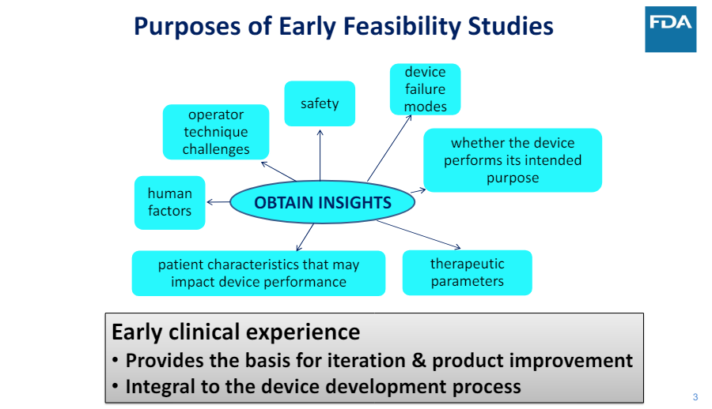
Introduction: Context (V)
Characteristics of an EFS
Medical Device Innovation Consortium. 2022. https://mdic.org/wp-content/uploads/2022/09/SNIS-slide-deck-EFS-presentation.pdf

Slide 8
Introduction: Context (VI)
Characteristics of an EFS
WHAT?
A clinical investigation in a limited number of patients (<15).
WHEN?
Usually, before the design of the device has been finalized, for a specific indication.
When the necessary information (e.g. Safety, performance, etc.) cannot be obtained from pre-clinical studies, or when these studies are not adequate.
WHY?
It can be used to evaluate the design concept of the device with respect to initial clinical safety and clinical performance or efficacy of the device (if applicable) based on the intended use in a small number of subjects. Information obtained from early clinical feasibility research can guide device modifications.
Early clinical feasibility research does not necessarily involve the first clinical use of a device.
Maximise the possibilities of developing innovative, cost-effective and safe medical technologies, even if they are high-risk.

Slide 9
Introduction: Context (VII)
Characteristics of an EFS
Types of devices suitable for EFS
Devices designed to treat severe conditions or unmet needs.
Devices with a high degree of novelty (i.e. disruptive innovations) and high potential to improve existing clinical standards.
Mature technologies used for a new indication, or even devices that introduce incremental innovations compared to previous generations.
Application Process
Applicants should clearly justify the suitability of the EFS to answer the intended research questions and why further preclinical testing would not be appropriate.
The assessment of the adequacy and completeness of the preclinical evidence should also include any potential in silico applications (i.e. computer simulation) that may contribute to further reducing uncertainty about the operation of the device prior to its use in human subjects

Slide 10
Introduction: Context (VIII)
Characteristics of an EFS
Preclinical evidence
Carry out a risk analysis to identify all possible failures and consequences of the device on patients. For each of the identified risks, special attention should be paid to defining an appropriate risk mitigation strategy to minimize the additional risk incurred by the patient during the study and if there is no evidence to say that the risks have been controlled, propose alternative measures.
Risk analysis should also include evaluation by highly specialized non-clinical experts (e.g., biomedical engineers) to verify the technical characteristics of the devices, the suitability of construction materials and production processes, and the congruence between the description of the device and its mechanism of action with the expected operation.
To find a balance between the available preclinical evidence, the necessary preclinical evidence and feasible preclinical evidence at the time of presentation, as design changes are expected to occur after the EFS study.

Slide 11
Introduction: Context (IX)
Characteristics of an EFS
Patient protection measures (e.g., informed consent)
Informed consent must adequately and correctly inform the patient about the early stage of device development and the related risks. Patients should be provided with comprehensive information about their condition, treatment options, reasons behind the proposal to enroll in the EFS, and risk/benefit considerations.
It is advisable to incorporate a DSMB (Data Safety Monitoring Board) or predefine criteria for the termination of the study or use of the product in the patient.
Center selection criteria
EFS require close monitoring of patients and a greater ability to respond quickly to any adverse event, but they also require the ability to culturally manage a high rate of failures (e.g., higher mortality or adverse events). In general, high-volume teaching and research hospitals are considered the most appropriate scenario for the performance of EFS.

Slide 12
Introduction: Context (X)
Characteristics of an EFS
Patient selection criteria
Critically ill patients without available alternative treatments would likely ensure a positive risk-benefit ratio in EFS applications.
The enrollment of lower-risk patients must be verified on a case-by-case basis, after considering the existing risk profile of the investigational device and the available alternatives.

Slide 13
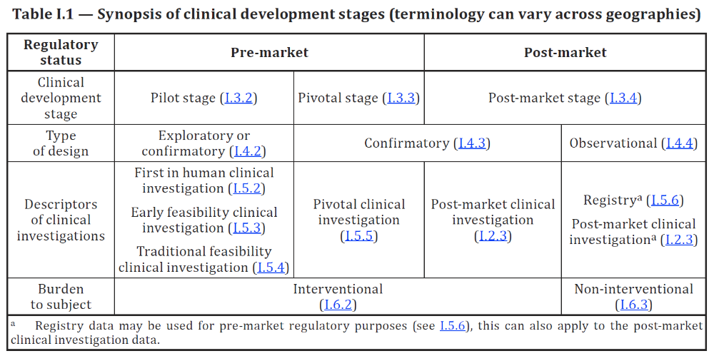
Introduction: Context (XI)
Why an EFS program in EU?
Feasible in the EU, they have already been carried out although they have not been categorised as such.
Contemplated by the general regulatory framework:
  ISO 14155:2020 Clinical research of medical devices for human subjects — Good clinical practice (GCP).
  MDR 2017/745 Early dialogue and life-cycle approach to clinical evidence generation.
  MDCG 2021-6 Clinical Research Questions and Answers.
Beneficial for companies, patients and health centers that develop technological innovation.

Slide 14
Introduction: Context (XII)
Why an EFS program in EU?
There is no common standardised procedural framework, guidelines or reference standards for carrying out EFS in the EU.
The EU risks losing competitiveness and attractiveness for innovation and investment.
Investments in R&D (million euros) in the healthcare equipment and services industry(Grassano et al 2022)
CAGR (Compound Annual Growth Rate) of the global medical technology market2017-2022 (Statista)

Slide 15
The HEU-EFS
Objectives (I)
General objective:
To make recommendations for the establishment of a harmonised EFS program within the EU, with a focus on ensuring patient safety and improving the competitiveness of the EU Single Market.

Slide 16
The HEU-EFS
Objectives (II)
Start date: October 1, 2023
Duration: 4 years
19 Million € Grant
1
Research and analysis
2
Networking
3
Methodology
4
Pilot and testing
5
Monitoring
6
Dissemination
To carry out research and analysis on (i) the state of the art of the regulatory framework and (ii) the characteristics and impacts of pre-market programs.
To implement a dedicated, sustainable, open access and informative online portal dedicated to the EFS, and to disseminate the results and recommendations of the project.
To build a network of stakeholders to promote the implementation of EFS in the EU.
To develop instruments to monitor the functioning of the EU EFS program.
Develop (i) a robust, broadly applicable and harmonised EU methodology and (ii) recommendations for the adoption of EFS.
Carry out pilot use cases to test the proposed methodological framework.

Slide 17

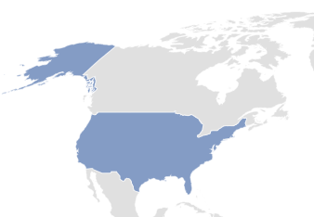






The HEU-EFS
The consortium
ACADEMIA
HTA AGENCIES
HEALTHCARE PROVIDERS
Assistance Publique Hôpitaux De Paris
AGENAS, Italy
Bocconi University (leader)
Trinity College Dublin
Fundació Clínic per a la Recerca Biomèdica & Hospital Clínic de Barcelona
NIPH, Norway
Marburg University
Fondazione Policlinico Universitario Agostino Gemelli IRCCS
Odense University Hospital
PATIENT ORGANIZATIONS
SMEs
CRO
Meditrial
Carmat
European Patients’ Forum
Global Heart Hub
Newronika
Idris Oncology
Qurasoft
TECHNOLOGY DEVELOPERS
Edwards Lifescience (coordinator)
Abbott
DePuy Synthes
Medtronic
Philips
WL Gore
22 members (16 public- 6 private from 13 countries):
9 EU (BE, CZ, DE, DK, ES, FR, IE, IT, NL)
1 EEA (NO).
3 no-EU (UK, CH, US).

Slide 18
The HEU-EFS
External Advisory Board
COMPETENT AUTHORITIES
MEMBERS OF ETHICS COMMITTEES
NOTIFIED BODIES
HPRA
Team-NB
Norwegian National Ethical Committee
Italian Ministry of Health
INFARMED
IMQ
Italian National Coordination Center of Ethics Committees
PROFESSIONAL ASSOCIATIONS
TRADE ASSOCIATION
MedtechEurope
EACTS
ESC
EFORT
IFMBE / EAMBES
INDEPENDENT EXPERTS
Amie Smirthwaite

Slide 19
Deliverables
Templates for clinical investigation protocol, patient informed consents, clinical site contracts, and insurance agreements
HEU-EFS Online portal
HEU-EFS Research reports
Guidance and recommendations on EU EFS
HEU-EFS Databases
Papers

Slide 20

HEU-EFS
Acceptability will be driven by the commitment of a wide network of stakeholders:
Universities
Hospitals
Contract Research Organizations (CROs)
Patient associations
Health Technology Assessment Agencies
MedTech companies and start-ups
Regulatory Authorities
Notified Bodies (NB)
Professional Associations

Slide 21




www.heuefs.eu
@HEU-EFS
@HEUEFS
info@heuefs.eu
Thank you
https://heuefs.eu/a-video-guide-to-the-heu-efs-project/
This project is supported by the Innovative Health Initiative Joint Undertaking (JU) under grant agreement No 101112185. The JU receives support from the European Union’s Horizon Europe research and innovation programme and life science industries represented by MedTech Europe, COCIR, EFPIA, Vaccines Europe and EuropaBio.

