Slide 1
Empowering European Innovators with Early Feasibility Studies
MedTech Forum 2025
14th May 2025

Slide 2
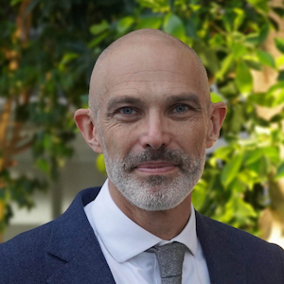
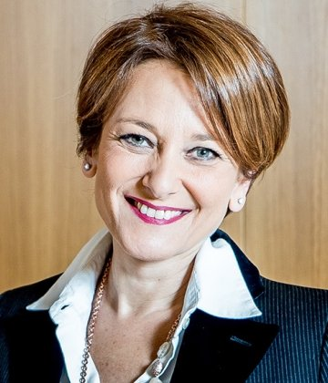


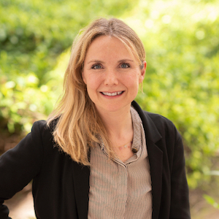

Welcome to the Panel
Niklas Blomberg
Moderator
Innovative Health Initiative
Rosanna TARRICONE
HEU-EFS Consortium Public Lead
SDA Bocconi
Alexandra POULSSON
Public Authority perspective
Norwegian Institute of Public Health
Laura SAMPIETRO-COLOM
Hospital perspective
Clinic Barcelona University Hospital
Fanny VAN DER LOO
Industry perspective
Edwards Lifesciences – Industry lead
Yasemin ZEISL
Patients’ perspective
European Patients' Forum

Slide 3



The HEU-EFS project
Objectives
Improve Early Patient Access
Elevate Clinical Excellence in European centres
Accelerate Investment into R&I in the European Union
A Harmonised approach to Early Feasibility
Studies for medical devices In the EU
20 Million EUR
22 Public-Private Partners
4 years (‘23 – ’27)
1
Research &
Analysis:
State of Play, Barriers,
Best practice
2
HEU EFS Methodology:
Incl process, templates, database, KPIs
3
Pilot Use-Cases:
Pilots to test & validate the methodology
Funded by the European Union, the private members, and those contributing partners of the IHI JU. Views and opinions expressed are however those of the author(s) only and do not necessarily reflect those of the aforementioned parties. Neither of the aforementioned parties can be held responsible for them.

Slide 4


The Challenge
Bringing medical technology innovations to patients in the EU has become increasingly long and difficult.
Rising R&D costs.
Uncertainty for innovators.
Ever-stricter EU regulations.
Decline in attractiveness of Europe.
Lack of harmonised approaches in Member States for facilitating early evidence generations.
European patients missing out on the latest medical technology innovations.

Slide 5

Expected Impact
Increase access to innovation for patients with no or few treatment options for technologies that may improve prognosis & quality of life.
Payers and policymakers make evidence-based, informed investment decisions that meet patient needs and generate value for society.
Technology providers develop innovations that meet healthcare professional & patient needs.
Healthcare professionals deepen their clinical development excellence.
Patients
Health systems
Clinical & innovation excellence

Slide 6



@HEUEFS
www.heuefs.eu
@HEU-EFS
info@heuefs.eu
Thank you
This project is supported by the Innovative Health Initiative Joint Undertaking (JU) under grant agreement No 101112185. The JU receives support from the European Union’s Horizon Europe research and innovation programme and life science industries represented by MedTech Europe, COCIR, EFPIA, Vaccines Europe and EuropaBio.

